Slide 1
OpenStack and Cloud Foundry
Infrastructure and Platform as a Service
Arun Ramakrishnan – IBM Digital Marketplace
July 25, 2016

Slide 2
Cloud service models
Infrastructure as a Service
OpenStack
Platform as a Service
Cloud Foundry
Areas of ongoing work and improvement

Slide 3
Separation of responsibilities
Infrastructure (as a Service)
Platform (as a Service)
Software (as a Service)
On-Premises
Applications
Applications
You manage
Applications
Applications
Data
You manage
Data
Data
Data
Runtime
Runtime
Runtime
Runtime
Middleware
Middleware
Middleware
Others manage
Middleware
You manage
O/S
O/S
Others manage
O/S
O/S
Virtualization
Virtualization
Virtualization
Virtualization
Others manage
Servers
Servers
Servers
Servers
Storage
Storage
Storage
Storage
Networking
Networking
Networking
Networking

Slide 4
Infrastructure as a Service
The most basic cloud service model
Serves to abstract a consumer from physical resources, location, data partitioning, scaling, security, backup …
Service providers will also provide services such as Image libraries and management, Block/Object storage, Firewalls, Load balancers, IP addresses, Virtual LANs
What you’ll do with an IaaS service:
Create servers (Bare metal / Virtual)
CPUs, Memory, Storage, Network, O/S etc.
Provision storage (Object / Block / File)
Networking (IP Addresses, VLANs)
Public, private networks
Management and imaging
Datacenters
Monitor, report
Typically bill by usage
Softlayer
Amazon Web Services
Rackspace
Joyent
Windows Azure

Slide 5
OpenStack
Free/Open source platform for cloud computing to support the IaaS model started by Rackspace Hosting and NASA
Deployed as multiple components that control datacenter resources
Hardware processing pools
Storage
Networking
Major components
Compute Nova | Image Glance | Object Storage Swift | Dashboard Horizon | Identity Keystone | Networking Neutron | Block Storage Cinder | Orchestration Heat | Telemetry Celiometer
Database Trove | Elastic Map Reduce Sahara | Bare Metal Ironic | Messaging Zaqar | Shared File System Manila | DNS Designate | Key Manager Barbican | Search Searchlight | Containers Magnum

Slide 6
Compute - Nova
Image - Glance
Object Storage - Swift
Dashboard - Horizon
Identity - Keystone
Networking - Neutron
Block Storage - Cinder
Orchestration - Heat
Telemetry - Celiometer
Database - Trove
Elastic Map Reduce - Sahara
Bare Metal - Ironic
Messaging - Zaqar
Shared File System - Manila
DNS - Designate
Key Manager - Barbican
Search - Searchlight
Containers - Magnum

Slide 7
Platform as a Service
A cloud computing service that provides a platform what allows customers to develop, deploy, run and manage applications in the cloud without having to worry about any of the underlying infrastructure
Focus on the code
Write applications in a language of your choice
Plug in external services to add capabilities
Easily scale applications
No need to worry about networking, storage or any other infrastructure
What you’ll do with a PaaS service:
Develop, create and deploy applications
Run applications on different runtimes seamlessly
Create and consume services
Scale applications
Manage/monitor applications
IBM Bluemix
Heroku
Windows Azure
Google App Engine
Engine Yard

Slide 8
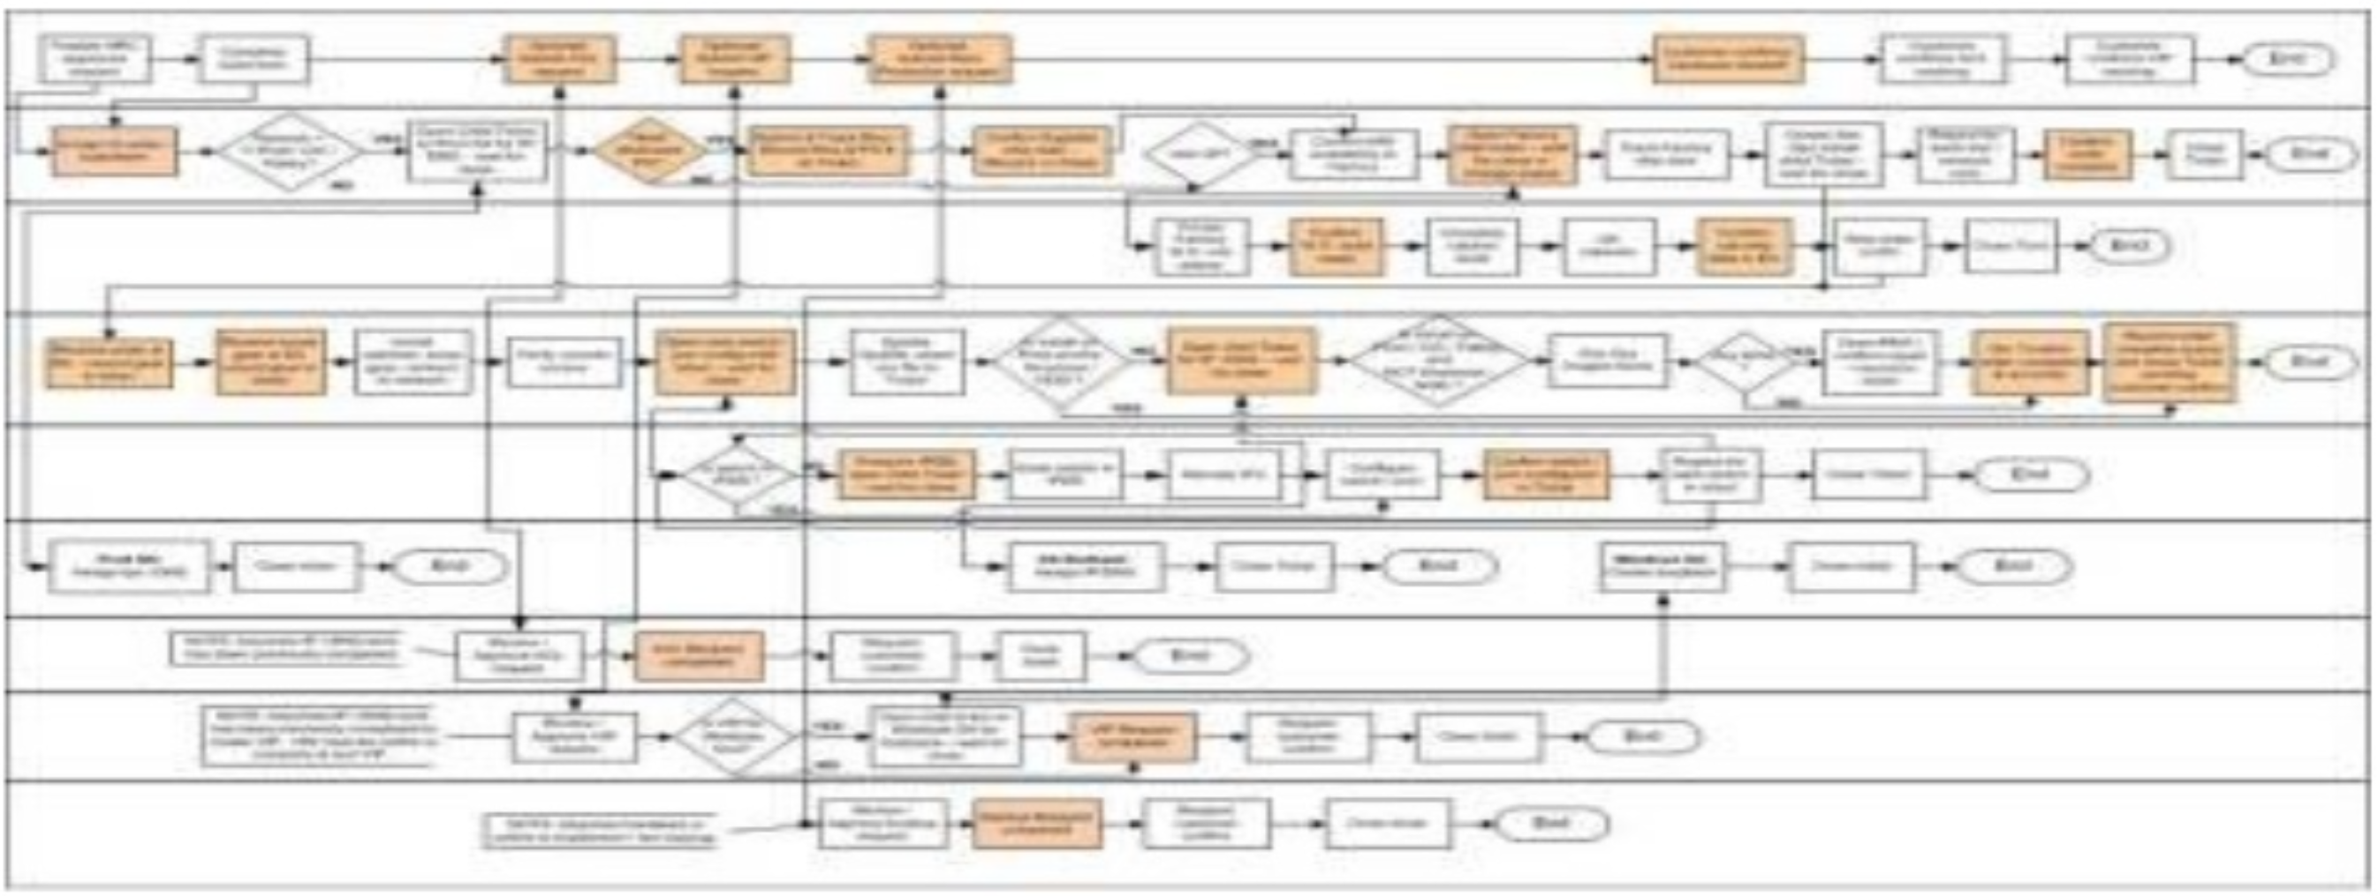
Create the cloud (Operator)
cf-iaas.yml
provision <my cloud>
add_capacity <my cloud>
Deploy my application (Developer)
target <my cloud>
push <my app>
create <service>
bind <service>

Slide 9
Router – Route to the Cloud controller or app
Auth/Login
Cloud controller – Directs deployments
nsync, Cell Reps – Maintains health
Diego Brain – One per app VM. Manage app, and report status
Blob store – App code packages, buildpacks, droplets
App Exec, Garden – Create, manage container lifecycle
Service broker – Provides service instances
BBS, Consul – Stores short/long term app info and control data
Metrics collector, App log aggregator – Help monitor an app
BOSH – Bridge to the underlying IaaS (e.g. OpenStack)

Slide 10
BOSH
Handles release management, deployment and lifecycle management of cloud software developed to deploy the Cloud Foundry PaaS
Stemcell – a versioned O/S image in IaaS specific packaging
Base minimum O/S, a few utilities, BOSH agent, basic security
Release – the collection of properties, config., scripts, source, binary etc. required to build and deploy software in a reproducible way on a Stemcell
Deployment – a collection of VMs built from Stemcells with Releases on them with the disks holding persistent data.
Deployment manifest
---
name: redis-us
releases:
- name: redis
version: 15.9
resource_pools:
- name: all-machines
stemcell:
name: bosh-aws-xen-ubuntu-trusty-go_agent
version: 2972
network: default
cloud_properties:
instance_type: m1.small
availability_zone: us-east-1a
...

Slide 11
CF Concepts
Online shopping App Org
Production Space
Application
Route 1
Route 2
Route n
Stack
Build pack
Memory
Environment variables
Instances
Host/route
etc. …
Organization
Space
Application
Stack (prebuilt root file system)
Buildpack (app framework/runtime)
Services
Routes
Assign one or more public routes to an application
App 1
App. Instances
App 2
App 3
App n
Service 1
Service 2
Service 3
Service n
Test Space
Routes, applications and services representing a test environment
Development Space
Routes, applications and services representing a dev environment

Slide 12
Staging an application
The CF CLI initiates the operation. Upload app artifacts and configuration
Identify the buildpack to use
Fetch buildpack and app files
Stage app
Get a container/stack/stemcell
Deploy buildpack along with application
Stream status for monitoring
Regularly notify of status

Slide 13
In brief
Cloud services provide value by abstracting various levels of complexity from it’s consumers through the use of automation
Infrastructure as a Service (OpenStack)
A cloud service that provides cloud infrastructure to a consumer
Physical compute
Network
Storage
etc.
Platform as a Service (Cloud Foundry)
A cloud service that provides a platform to deploy and manage applications by hiding underlying infrastructure
Would typically be running on top of an IaaS

Slide 14
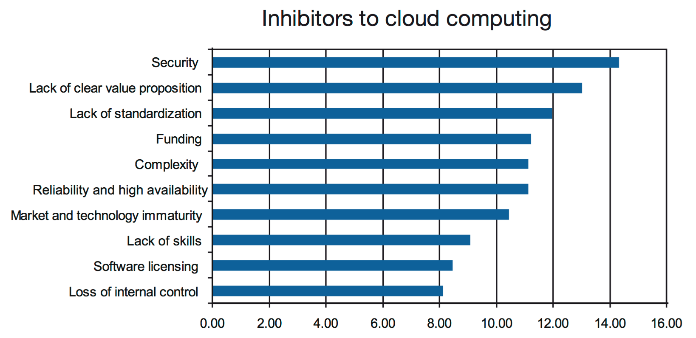
Inhibitors to cloud computing
Today
Security
Privacy
Compliance
Interoperability
Lock-in
Taken from “Cloud computing insights from 110 implementation projects IBM Academy of Technology Survey, October 2010”

Slide 15
Areas of work/thought
CAP Theorem (A.K.A Brewer’s Theorem after Eric Brewer)
It is impossible for a distributed computer system to simultaneously provide all three of the following guarantees:
Consistency (all nodes see the same data at the same time)
Availability (every request receives a response about whether it succeeded or failed)
Partition tolerance (the system continues to operate despite arbitrary partitioning due to network failures)
Cognitive Computing
Internet of Things (Ubiquitous/Pervasive computing)
Security
Mobile
Analytics
Automation
Reliability
Availability
Scalability
Recovery

